Slide 1
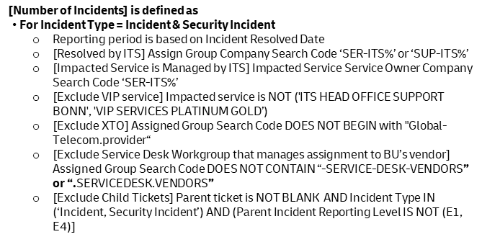
Root Cause Focus – Root causes identified for Emergency incidents for ITS managed solutions (1 of 2)
E | T | M
87.3% | 88.3% | 89.3%
Root Cause Identified, RCI
Measures IT Services’ ability to find root cause(s) for incidents and eliminate them. The “Incidents” in Root Cause Focus is defined as Emergency Incidents and Security Incidents. This KPI measures the percentage of Incidents for ITS managed solutions has Root Cause Identified. ITS Managed Solutions refers to ITS Managed Services.
2025_1
$$\text{Root} \text{Cause} \text{Identified} \text{(\%) }=\frac{\text{No} \text{of} Incidents \text{with} \text{root} \text{cause} \text{Identified} }{\text{Number} \text{of} Incidents}X 100\%$$
[Number of $\text{Incidents}$] is defined as
For Incident Type = Incident & Security Incident
Reporting period is based on Incident Resolved Date
[Resolved by ITS] Assign Group Company Search Code ‘SER-ITS%’ or ‘SUP-ITS%’
[Impacted Service is Managed by ITS] Impacted Service Service Owner Company Search Code ‘SER-ITS%’
[Exclude VIP service] Impacted service is NOT ('ITS HEAD OFFICE SUPPORT BONN', 'VIP SERVICES PLATINUM GOLD’)
[Exclude XTO] Assigned Group Search Code DOES NOT BEGIN with "Global-Telecom.provider“
[Exclude Service Desk Workgroup that manages assignment to BU’s vendor] Assigned Group Search Code DOES NOT CONTAIN “-SERVICE-DESK-VENDORS” or “.SERVICEDESK.VENDORS”
[Exclude Child Tickets] Parent ticket is NOT BLANK AND Incident Type IN (‘Incident, Security Incident’) AND (Parent Incident Reporting Level IS NOT (E1, E4)]
For Incident Type = Incident
Reporting Level = Emergency E1, E4
Incident Status is Resolved, Informed or Closed
Exclude ticket with Closure code = Not Resolved (Duplicate), Not Resolved (No Response from User), Not Resolved (Conflicts with Standards and Policy), Not Resolved (Withdrawn by User)
For Incident Type = Security Incident
Severity Class = Very High and High
Entry vector IS NOT "False Positive“
Sensitivity IS NOT highly sensitive (ticket contents to follow sensitivity rule)
Closure Code contains ‘Resolved’
Manoj Menon, ISQ
Alina Tofan, Service Quality
Edward Yin, Service Quality
Global ServiceNow
Daily

Slide 2
Root Cause Focus – Root causes identified for Emergency incidents for ITS managed solutions (2 of 2)
E | T | M
87.3% | 88.3% | 89.3%
Root Cause Identified, RCI
Measures IT Services’ ability to find root cause(s) for incidents and eliminate them. The “Incidents” in Root Cause Focus is defined as Emergency Incidents and Security Incidents. This KPI measures the percentage of Incidents for ITS managed solutions has Root Cause Identified. ITS Managed Solutions refers to ITS Managed Services.
2025_1
$$\text{Root} \text{Cause} \text{Identified} \text{(\%) }=\frac{\text{No} \text{of} Incidents \text{with} \text{root} \text{cause} \text{Identified} }{\text{N}\text{o} \text{of} Incidents }X 100\%$$
[No of Incidents with Root Cause Identified] is defined as
For Incident Type = Incident
Incident closure code = “Resolved ( Permanent Fix) “ AND QC Tags[Ticket Quality Indicator] = ‘ %Pass’
Incident closure code = “Resolved ( Permanent Fix) “ AND QC Tags [Ticket Quality Indicator] = ‘ %Fail’ AND ‘No of Fields updated after 2 hours resolution’ IS NOT NULL
Exclude Problem Tickets with Closure Code = “Not Solved / Rejected”
Incident with Linked Problem and Problem State = Solution Investigation, Solution Acceptance, Solution Development, Solution Implementation, Solution Validation OR
Incident with Linked Problem and Problem State = Closed AND [ Problem Closure Code IN (‘Solved / No RfC Needed’, ’ Solved / RfC Implemented’,’ Not Solved / Unable to Solve’, ‘Not Solved / Workaround’)
if an Incident is related to only 1 PRB and the PRB Closure Code is (Not Solved / Rejected) , then it means the Incident has no valid Problem and does not meet the KPI.
If an incident is related to multiple problem tickets,
(a) Problems with Closure Code (Not Solved / Rejected) should be excluded and NOT use to determine fulfillment of the KPI
(b) Only the first linked problem ticket is used to determine KPI fulfillment. [Different from 2024 Definition]
Incident Type = Security Incident
Ticket is Tag with #SIVRC OR #SIVS OR #SIAP
Manoj Menon, ISQ
Alina Tofan, Service Quality
Global ServiceNow
Daily

Slide 3
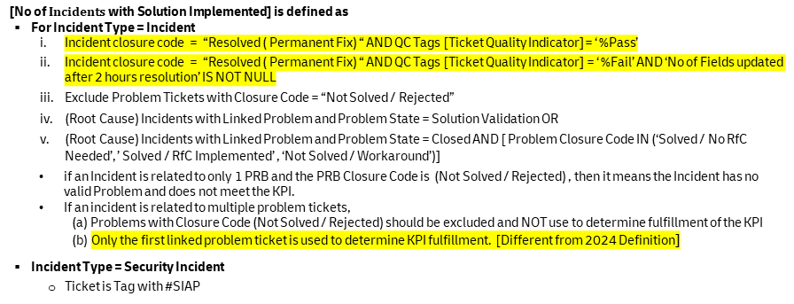
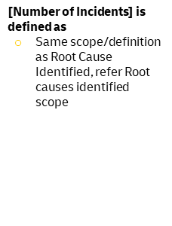
Root Cause Focus – Solution Implemented
E | T | M
74.8% | 75.8% | 76.8%
Solution Implemented, SolImp
Measures IT Services’ ability to find root cause(s) for Incidents and eliminate them. The “Incidents” in Root Cause Focus is defined as Emergency Incidents and Security Incidents. Solution Implemented measures the percentage of Incidents with Solution implemented
2025_1
Solution Implemented ($\%)=\frac{\text{No} \text{of} \text{Incidents} \text{with} \text{Solution} \text{Implemented} }{\text{Number} \text{of} \text{Incidents} } X 100\%$
[Number of $\text{Incidents}$] is defined as
Same scope/definition as Root Cause Identified, refer Root causes identified scope
[$\text{No} \text{of} Incidents \text{with} \text{Solution} \text{Implemented}$] is defined as
For Incident Type = Incident
Incident closure code = “Resolved ( Permanent Fix) “ AND QC Tags [Ticket Quality Indicator]= ‘ %Pass’
Incident closure code = “Resolved ( Permanent Fix) “ AND QC Tags [Ticket Quality Indicator] = ‘ %Fail’ AND ‘No of Fields updated after 2 hours resolution’ IS NOT NULL
Exclude Problem Tickets with Closure Code = “Not Solved / Rejected”
(Root Cause) Incidents with Linked Problem and Problem State = Solution Validation OR
(Root Cause) Incidents with Linked Problem and Problem State = Closed AND [ Problem Closure Code IN (‘Solved / No RfC Needed’, ’ Solved / RfC Implemented’ , ‘Not Solved / Workaround’)]
if an Incident is related to only 1 PRB and the PRB Closure Code is (Not Solved / Rejected) , then it means the Incident has no valid Problem and does not meet the KPI.
If an incident is related to multiple problem tickets,
(a) Problems with Closure Code (Not Solved / Rejected) should be excluded and NOT use to determine fulfillment of the KPI
(b) Only the first linked problem ticket is used to determine KPI fulfillment. [Different from 2024 Definition]
Incident Type = Security Incident
Ticket is Tag with #SIAP
Manoj Menon, ISQ
Alina Tofan, Service Quality
Global ServiceNow
Daily

